Slide 1



Datacore Consultants
Decoding Success with AI : Our Algorithms, Your Growth!

Slide 2

About Us
We are a result-driven consulting organization committed to continuous learning and improvement, staying abreast of industry trends, emerging technologies, and best practices.
Our success lies in helping our clients achieve their goals while upholding the highest ethical standards.
Our team of seasoned domain experts at Datacore Consultants brings a wealth of experience in data engineering, machine learning, and advanced analytics.

Slide 3

Our Key Solutions
NEUROSCORE AI
BOOKWORM
Revolutionize businesses with AutoML and MLOps
An Intelligent Data Companion

Slide 4
Case Study
Dependencies & Challenges faced by businesses in ML Model Development and Deployment
Business Analysts, despite having valuable insights, often find themselves reliant on Data Scientists and Analysts for the creation of ML models. This coding dependency arises due to the extensive programming and advanced statistical techniques required in model building.
The process of developing ML models by Data Scientists can typically span between 2-3 weeks. Furthermore, these models are usually deployed on local machines, creating a dependency for ongoing tasks such as customer propensity scoring or risk-ranking.
Models deployed locally and recalibrated infrequently, often only once a year or less, tend to suffer from performance decay over time. This gradual degradation can lead to lower effectiveness in applications such as campaign conversions.
In current manual processes, there is often a lack of systematic monitoring for data drifts prior to scoring. This results in new drifts in model variables being identified only after losses have occurred, typically during post-incident root cause analysis

Slide 5




Our Proposed Solution
NEUROSCORE AI
Revolutionize businesses with AutoML and MLOps
100% No Code Platform / No Coding Required
User-friendly interface designed for accessibility, allowing users of varying technical backgrounds to navigate and utilize the platform productively
Automated & Versatile Model Building Application
Easily define your target variables and select from a variety of model types for versatile model building. Example : Classification, Regression, Clustering, Forecasting
Continuous Improvement
Neuroscore AI constantly reinforces its learnings by incorporating new data into the model base for retraining, ensuring ongoing optimization and improved accuracy.
Data drift monitoring and Automated Alert Systems Stay informed with automatic data drift notifications, ensuring your models remain accurate and reliable over time.

Slide 6
Our Advantage over Competitors
NEUROSCORE AI
Revolutionize businesses with AutoML and MLOps
Features | Neuroscore AI (Datacore Consultants) | Competitors in India | Competitors in US / UK / UAE
Multiple Database Integration | Yes | No (Only csv supported) | No
Versatile Model Building | Yes | Yes | Yes
Quick vs Customized Method | Yes | No | No
No Code / Zero Code | Yes | Yes | Yes
Model Monitoring | Yes | No | Yes
Continuous Learning | Yes | No | Yes
Data Drift and Alert systems | Yes | No | No
Performance Dashboard | Yes | Yes | Yes
Detailed Evaluations Reports | Yes | Yes | No
A/B Testing for Campaigns | Yes | Manual | Manual
Level of Reduced Data Scientist dependencies | High | Low | Medium
Average Enterprise Cost (Annual) | $50,000 per user id | $3,00,000 per user id | $5,00,000 per user id
Model Data Row Count (Max) | Unlimited | 1M | Unlimited
Predictions Count (Max) | Unlimited | 5M | 2M
No of active deployed Models (Max) | Unlimited | 10 | 10

Slide 7
Case Study
Challenges faced by businesses in Business Reporting and Knowledge Transitions
Stage 1 : CXO requesting a new business KPI report from analyst
The process for acquiring business reports or numbers typically involves a minimum three-stage approach in most leadership structures. This inherent procedural complexity results in a turnaround time (TAT) of several hours, even for requests that might be relatively straightforward.
Frequent instances of minor human errors during query formulation often lead to a cycle of back-and-forth communication for a single report or data request. Such errors result in the sharing of incorrect data, subsequently extending the turnaround time as the need to correct and resend the information arises.
When faced with the task of reviewing and summarizing extensive documentation, such as research papers, the process becomes markedly time-consuming. Navigating through large volumes of data can take hours or even days, thereby delaying the summarization and any subsequent activities dependent on this information.
Stage 2 : Analyst writing queries and generating report
Stage 3 : Analyst delivering the report to CXO

Slide 8




Our Proposed Solution
BOOK WORM
An Intelligent Data Companion
Eliminating TAT with Advanced LLM Integrations
Integrated with complex Large Language Models, Book Worm deeply understands your data, offering precise insights to user queries
Intuitive Information Retrieval
Acting as a virtual analyst, it takes user requests to fetch data, analyze, and compile reports, streamlining stakeholder serving. It processes user requests, retrieving, analyzing, and compiling reports for enhanced stakeholder communication and decision-making.
Data Security
No data is shared externally , ensuring data security and confidentiality.
Versatile Data Sources
Effortlessly import text data from multiple formats (Text files, Word documents, PDFs, Excel, CSV) and establish direct connections to SQL or Teradata databases.

Slide 9
Our Advantage over Competitors
BOOK WORM
An Intelligent Data Companion
Features | Book Worm | Competitors
Multiple Database Integration | Yes | No
Conversational AI | Yes | Yes
Automated reporting capabilities | Yes | No
Data Privacy and Security Compliant | Yes | Shares data outside client environment
Live API Endpoints to integrate with existing Client UI | Yes | Yes
Reduce Data Analyst dependencies | Highly | Low
Enterprise Cost (Annual) | $36,000 per user_id | $276,000 per user_id
No of Users | Unlimited | Unlimited
Tokens limitation | 32,000 | 32,000

Slide 10
Meet Our Speech Assistants
AI Auditor
Vaani AI
Revolutionize Audits with Generative AI
An AI-Driven Excellence in Customer Service

Slide 11
Case Study
Dependencies & Challenges in Auditing and Rating Call Center Agent Performance
Customer Satisfaction Challenges: Call centers struggle to maintain high levels of customer satisfaction. Without monitoring tools, tracking KPIs like Net Promoter Score (NPS), Call Abandonment Rate, and Customer Satisfaction Score (CSAT) becomes difficult. This leads to suboptimal service quality.
Cost Management Issues: Inefficiencies and poor performance translate to higher operational costs. Inability to measure key metrics like Cost per Call (CPC) and Service Level (SL) leads to higher expenses and reduced profitability. This hinders business growth and customer retention.
Operational Efficiency Goals: Achieving operational efficiency is a key target for businesses. Without real-time data, managers cannot identify peak call times, leading to inadequate staffing during high-volume periods. This results in longer wait times, increased customer frustration, and negatively impacts NPS and overall service quality.
Time-Consuming Process: The manual review of calls is time-consuming, leading to delays in obtaining actionable insights.
Inconsistent Audits: Human auditors may have subjective biases, leading to inconsistent evaluation of agent performance.
Agent Performance Identification: Identifying exceptional and underperforming agents is a key challenge for management. Without detailed analytics, there is a lack of insights, hampering targeted coaching efforts. This affects the Quality Score, Occupancy Rate, and compliance rates, ultimately impacting the effectiveness of the call center team.

Slide 12








How does it work?
AI Auditor
Sentiment Analysis
Revolutionize Audits Process with Generative AI
Topic Modelling
Agent Performance Metrics
AI AUDITOR
Business SLA & Insights
Existing Calling Process
Multi-Channel
Call Recordings
Dashboard
Agent Comments or Call Notes

Slide 13


Key Features
AI Auditor
Transform Business with Cutting-Edge LLM Capabilities
Holistic Interaction Analysis:
100% comprehensive review of customer interactions across voice
Ensure no critical data is missed and gain comprehensive insights into customer experience
Ensuring SLA Achievements:
Identifying issues with soft skills, escalations, dead air, Zero Tolerance Policy (ZTP), and Average Handle Time (AHT).
Focus resources on the most impactful areas to enhance service quality.
QA Evaluation and Performance dashboard:
Generate detailed reports effortlessly for QA evaluation
Pinpoint specific improvement areas and visualize performance trends to drive targeted coaching
Enhanced Communication & Interaction Analytics:
Asses and review agent soft skills during escalation calls and identify the improvement zone for training.
Analyse the nuances of conversation, including interjection, response timing and objection handling to ensure effective solution to customer.

Slide 14
Case Study
Challenges faced by contact centres in maintaining Customer Satisfaction and Loyalty
Opportunities with Vaani AI to improve Customer Satisfaction and Loyalty
High Operational Costs: Maintaining a large team of human agents is expensive, with costs including salaries, training, and infrastructure.
Cost Reduction: By automating repetitive and low-value tasks, Vaani AI significantly reduces operational costs.
Agent Burnout: Repetitive and monotonous tasks lead to high employee burnout, impacting productivity and service quality. It also leads to high agent attrition.
Improved Agent Satisfaction: Offloading monotonous tasks to Vaani AI allows human agents to focus on more complex and rewarding interactions, reducing burnout and increases employee retention.
Scalability Issues: During peak times, it is challenging to scale human resources quickly to meet the increased call volumes.
Enhanced Scalability: Vaani AI can handle unlimited call volumes, ensuring seamless service during peak times.
Inconsistent Service Quality: Variability in agent performance can lead to inconsistent customer experiences.
Consistent Service Quality: Vaani AI provides consistent and accurate responses, enhancing overall customer satisfaction.
Negative ROI Processes: Certain processes, such as handling frequent simple queries, often result in negative ROI due to their high handling costs and low revenue impact.
Positive ROI: Automating processes with low ROI improves overall business profitability.

Slide 15


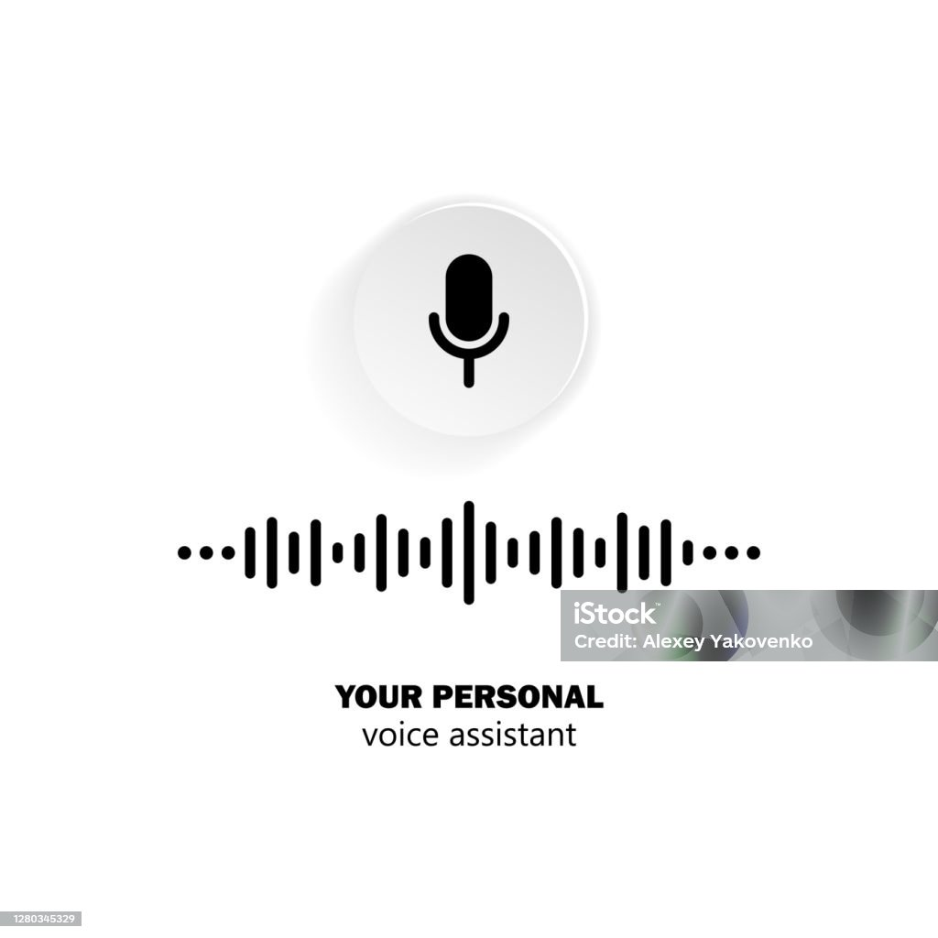

How does it work?
Vaani AI is an advanced AI-powered contact center representative designed to enhance customer service operations by automating call handling and providing real-time, human-like interactions. Unlike traditional automated systems, Vaani AI leverages state-of-the-art LLMs and Machine Learning algorithms to understand and respond to customer queries with high accuracy and empathy.
Vaani AI - Workflow
1
Speech To Text
Business Knowledge, SOP, Guidelines, etc.
2
Information Retrieval
Text To Speech
3

Slide 16
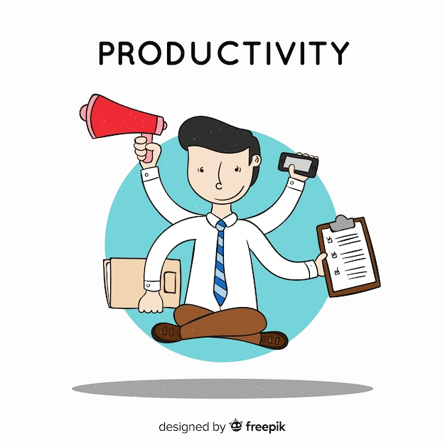
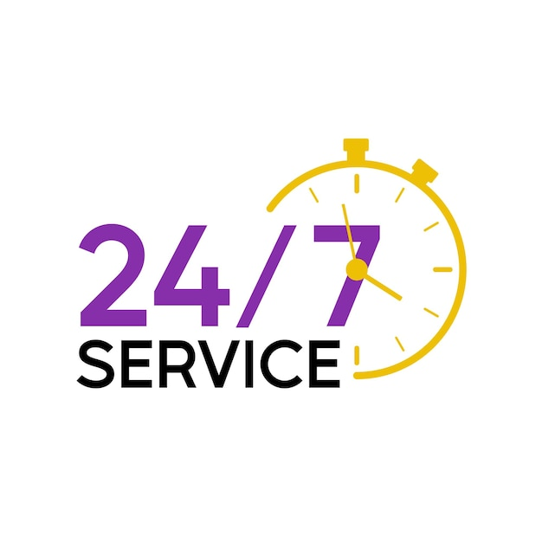



Key Features
Vaani AI
AI-Driven Excellence in Customer Service
Automating Routine Queries
Vaani AI efficiently handles routine queries, freeing up human agents for more complex tasks.
24/7 Availability
Unlike human agents, Vaani AI operates round-the-clock, providing uninterrupted customer support.
Real-Time Data Retrieval
Vaani AI can quickly access and retrieve information from business documents, ensuring accurate and timely responses.
Language and Accent Adaptation
Vaani AI is trained to understand and respond in multiple languages and accents, catering to a diverse customer base.
Scalable Solution
Whether it’s a sudden spike in calls or a need for long-term scalability, Vaani AI adjusts effortlessly to demand changes.

Slide 17
Our Analytics & Automation Solutions
Customer Propensity Models
Vision

Slide 18
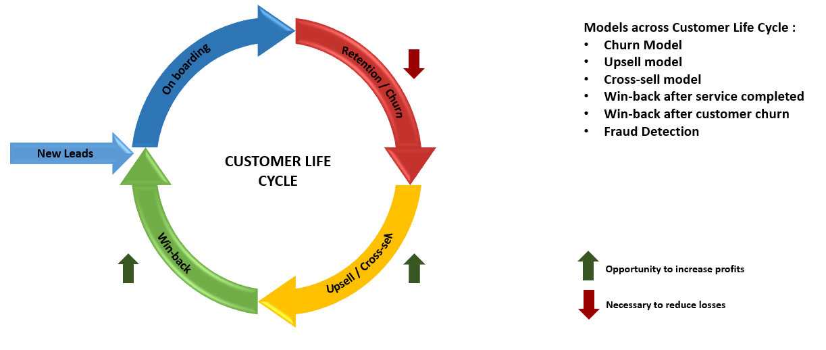
Our Solutions
CUSTOMER PROPENSITY MODELS
Objective : To develop the different types of propensity models in the customer life cycle using complex ML Classification algorithm.

Slide 19


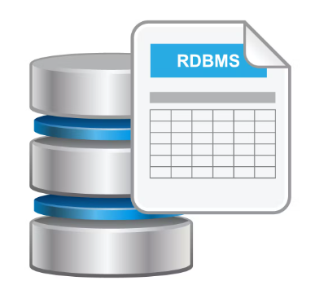

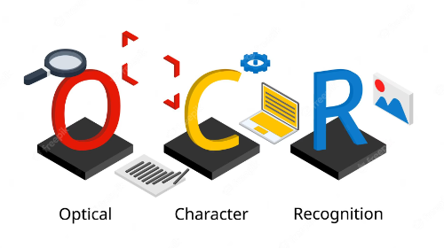
Our Solutions
VISION
Objective : Vision shaves the tedious and error-prone job of dealing with multiple pages of unstructured documents and extracting information from them for making business decisions. AI can help in extracting information from these documents, align it to common vocabulary, and make information easily accessible through an automated process that lasts about a few seconds using Optical Character Recognition (OCR) and Natural Language Processing (NLP).
Documents / Bills
Existing Process
Proposed Solution
API

Slide 20


Meet Our Leaders
Pritesh Jha, Co-founder & C.E.O
Rahul Mishra, Co-founder & C.O.O
Award winning Data Scientist with almost a decade of rich experience with multiple business domains including Healthcare in US, Life Insurance, Pharma, Media. Pritesh has authored courses for Data Science & AI with Python in partnership with leading EdTech firms in India.
Top of the class Engineer, Educated at IIT-Kharagpur, bringing vast knowledge in the areas of Petroleum, Financial Markets. Rahul has spearheaded sales and analytics for the leading petroleum organization in two states in the last 5 years in India

Slide 21
Our Vision
“In a world of limits, we see opportunities where others see barriers”
Our mission is to embrace challenges through unwavering commitment and strategic innovation, elevating the profitability of our partners with humility and resolve.

Slide 22




Contact Us
Pritesh Jha
Rahul Mishra
+91-983 311 5874
+91-897 667 0473
pritesh.jha@datacoreconsultants.com
rahul.mishra@datacoreconsultants.com
For further assistance, please reach out to our marketing team at the following:
marketing@datacoreconsultants.com
+91-897 658 1583
www.datacoreconsultants.com

Slide 23


Thank you

